Slide 1
RedGreen
AI-powered app for detecting watermelon ripeness and sugar level via image and sound analysis
Lee Tal and Dmitry Simon
Supervisors: Dr. Benny Mounits and Dr. Dan Lemberg
Capstone Project - Phase A
Notes:
L

Slide 2
Introduction

Slide 3
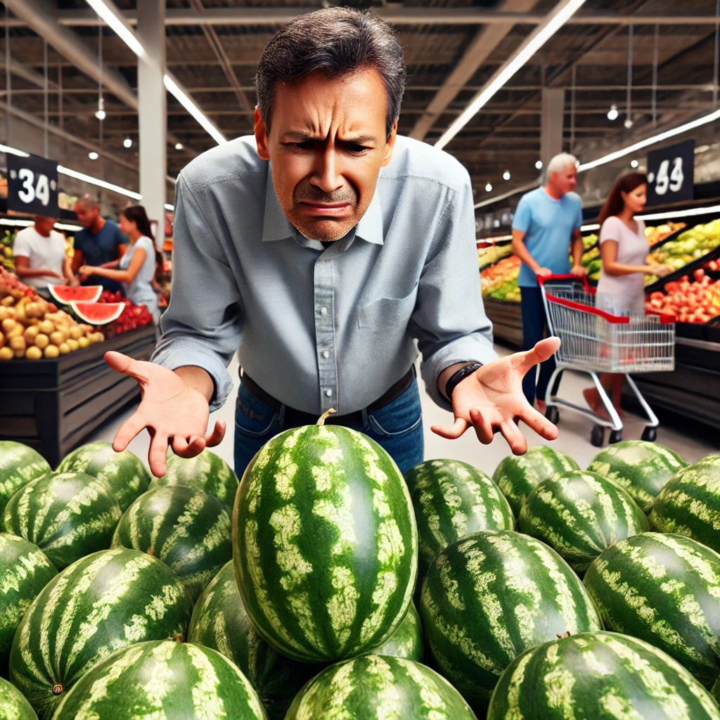
The problem
Inaccurate Ripeness Selection
Traditional ripeness checks like tapping and observing the peel are unreliable, leading to wrong choices and waste.
No Easy Testing Tools
Scientific methods require expensive lab equipment, leaving consumers with no simple, accurate solution.
Wasted Time and Effort
Shoppers spend too much time guessing ripeness, leading to frustration and poor purchases.
Notes:
דימה

Slide 4
Existing App Solutions
01
Melony
02
Watermelon Prober
Uses algorithms to analyze sound frequency when tapping a watermelon to determine ripeness.
Platform: Android and iOS
Rating: 2.4 out of 5 stars based on 9 ratings
Downloads: Over 10,000 downloads
Analyzes sound from tapping the fruit to assess ripeness.
Platform: Android
Rating: 2.8 out of 5 stars based on 402 reviews
Downloads: Over 100,000 downloads
03
Melon Aid
04
Clarifruit
Uses AI to analyze vibration responses and sound frequency to detect ripeness.
Platform: iOS
Rating: 2.2 out of 5 stars based on 5 ratings
Downloads: numbers are not provided
Utilizes AI-powered vision to assess fruit quality, including ripeness and sweetness, from photos.
Platform: Android and iOS
Rating: 3.0 out of 5 stars based on 3 ratings
Downloads: Over 5,000 downloads on Google Play
Notes:
לי

Slide 5
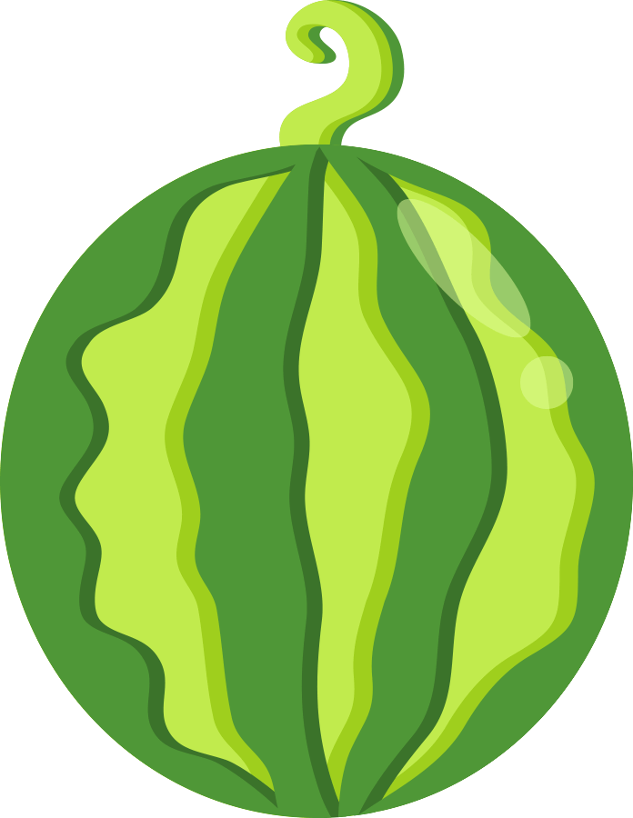
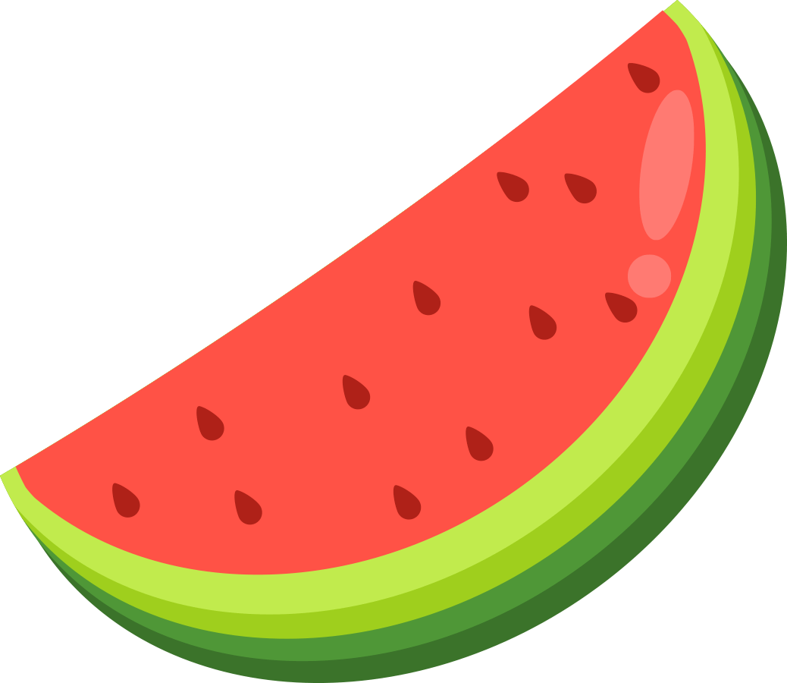
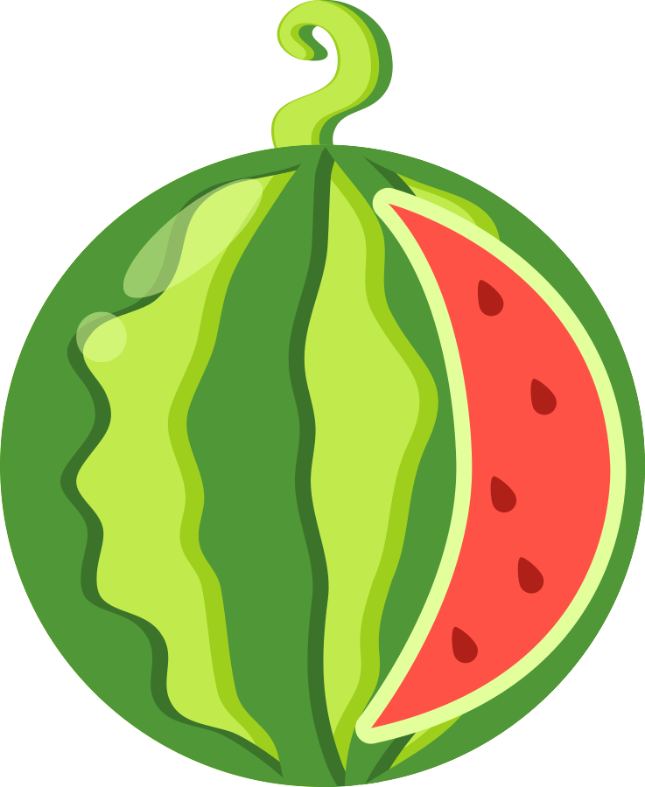
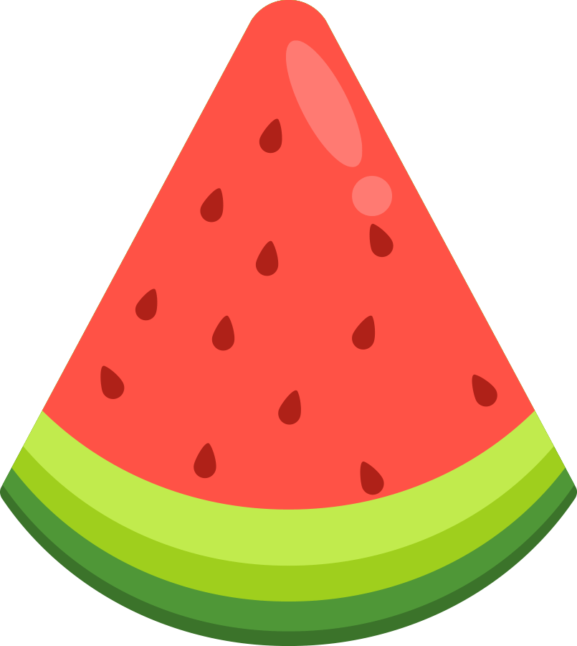
Our App Solution
User-Friendly UI
Dual-Modal Analysis
Clear guidance, noise prompts, and intuitive design.
Combines image and sound for better accuracy.
Cloud-Based Processing
Optimized AI Models
Faster, more precise than local models.
Fine-tuned for superior detection accuracy.
Notes:
D

Slide 6
Research

Slide 7
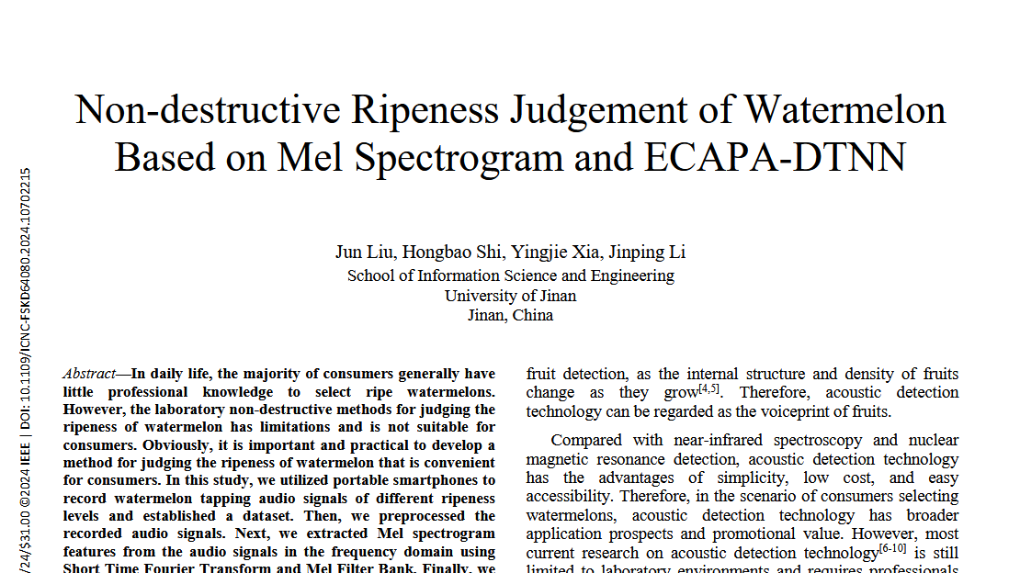
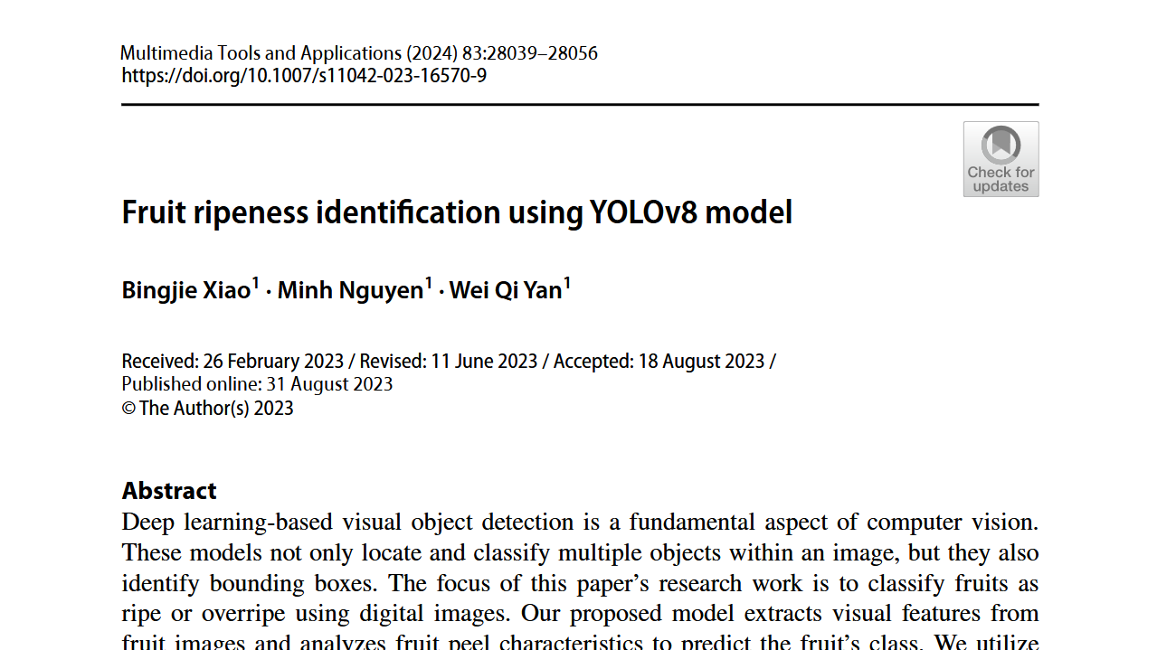
Non-destructive Ripeness Judgement of Watermelon Based on Mel Spectrogram and ECAPA-DTNN 08 October 2024
Articles used
Watermelon Ripeness via Audio Analysis
This study uses Mel spectrograms and ECAPA-TDNN to analyze watermelon tapping sounds, achieving 89.5% accuracy, offering a portable, cost-effective alternative to lab methods​
Fruit Ripeness Detection with YOLOv8
Using YOLOv8, this research classifies fruit ripeness based on peel features with 99.5% accuracy, leveraging fast, anchor-free AI for automated detection
Fruit ripeness identification using YOLOv8 model 18 August 2023
Notes:
L

Slide 8
From where the articles?
University of Jinan, China
Auckland University of Technology, New Zealand
Both studies come from leading research institutions focusing on AI applications in agriculture.
Notes:
L

Slide 9
Why this articles?
Well-Structured and Clear
Reliable and Credible Sources
High-Performance Models
These articles are well-organized, presenting clear methodologies, detailed experiments, and concise explanations, making them easy to understand and reference.
Both studies are peer-reviewed and published in reputable journals, ensuring scientific accuracy and trustworthy data for our research.
The studies utilize state-of-the-art AI models (ECAPA-TDNN & YOLOv8) with top accuracy (89.5% & 99.5%), proving their effectiveness in fruit ripeness detection.
Notes:
D

Slide 10
Key models & DataSets

Slide 11
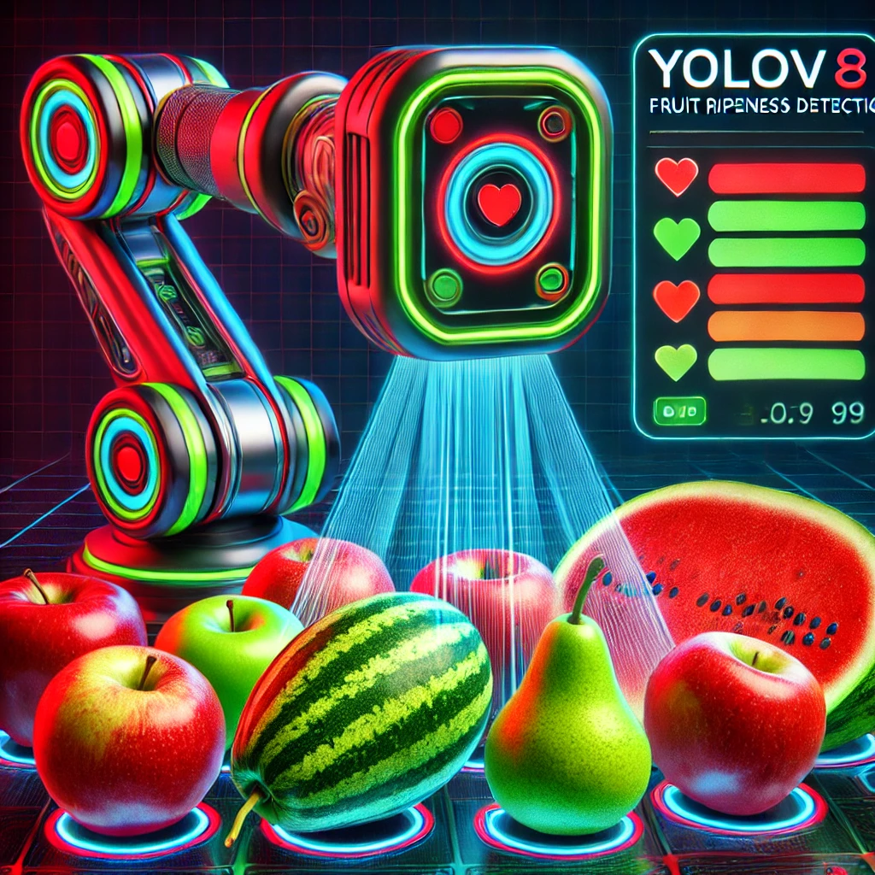
YOLOv8: The Future of Ripeness Detection
Unmatched Accuracy and Speed
With 99.5% accuracy and real-time processing, YOLOv8 outperforms older models using efficient, anchor-free detection​.
Optimized for Performance
Its C2f, Decoupled Head, Anchor-Free design, VFL, and DFL optimize speed, accuracy, and efficiency, making YOLOv8 ideal for real-time cloud and mobile applications.
Proven Through Rigorous Testing
Trained on diverse datasets, YOLOv8 handles occlusions, lighting variations, and complex fruit surfaces, ensuring consistent and precise results​.
Notes:
D

Slide 12

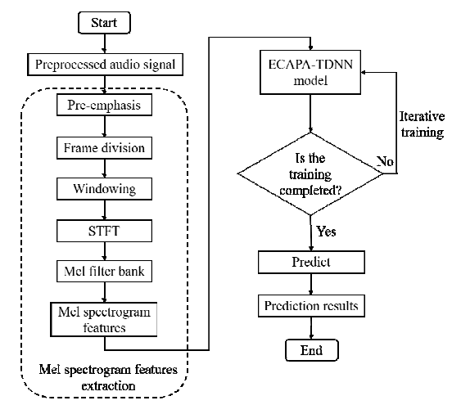
ECAPA-DTNN : Transforming Ripeness Detection Through Sound
Rich and Informative Features
Mel spectrograms capture detailed frequency patterns from tapping sounds, preserving key ripeness indicators that traditional audio analysis might miss​.
Optimized for Deep Learning
By reducing spectral complexity while maintaining essential data, Mel spectrograms enhance machine learning performance, leading to higher classification accuracy​.
Proven Accuracy in Ripeness Detection
Used with the ECAPA-TDNN model, Mel spectrogram analysis achieved 89.5% accuracy, proving its effectiveness in non-destructive watermelon ripeness testing​.
Notes:
L

Slide 13
Tapping Sounds
Sweetness Data
Recorded WAV files capture knock sounds, reflecting internal texture and ripeness.
A sugar meter measures sugar content, providing a numerical ripeness indicator.
DataSet
Visual Features
Integrated Data
High-quality JPEG images document color, texture, and shape, aiding ripeness evaluation.
The dataset correlates sound, visuals, and sweetness for comprehensive ripeness analysis.
Notes:
D

Slide 14
Diagrams

Slide 15
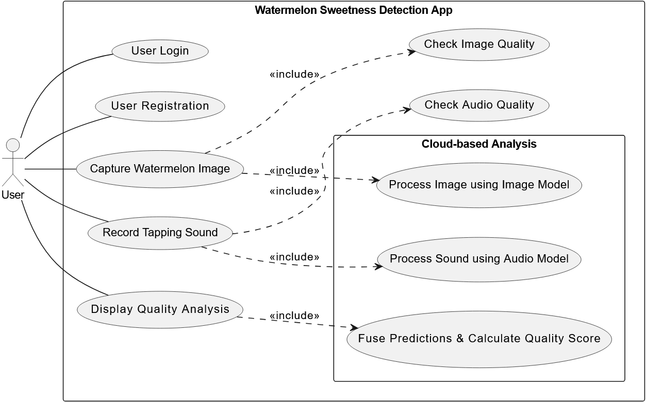
Use Case
Notes:
D

Slide 16
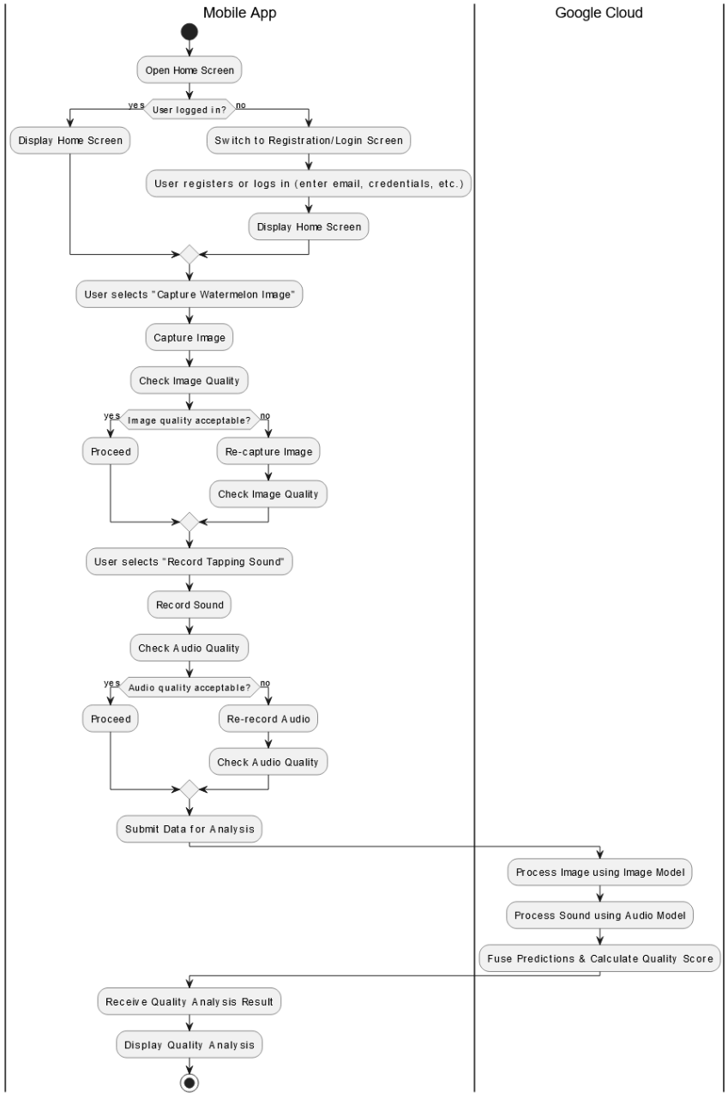
Activity Diagram
Notes:
D

Slide 17
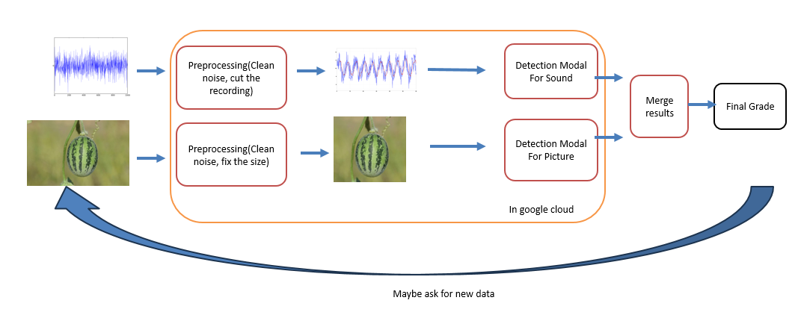
Back-end cloud Architecture
Notes:
L

Slide 18
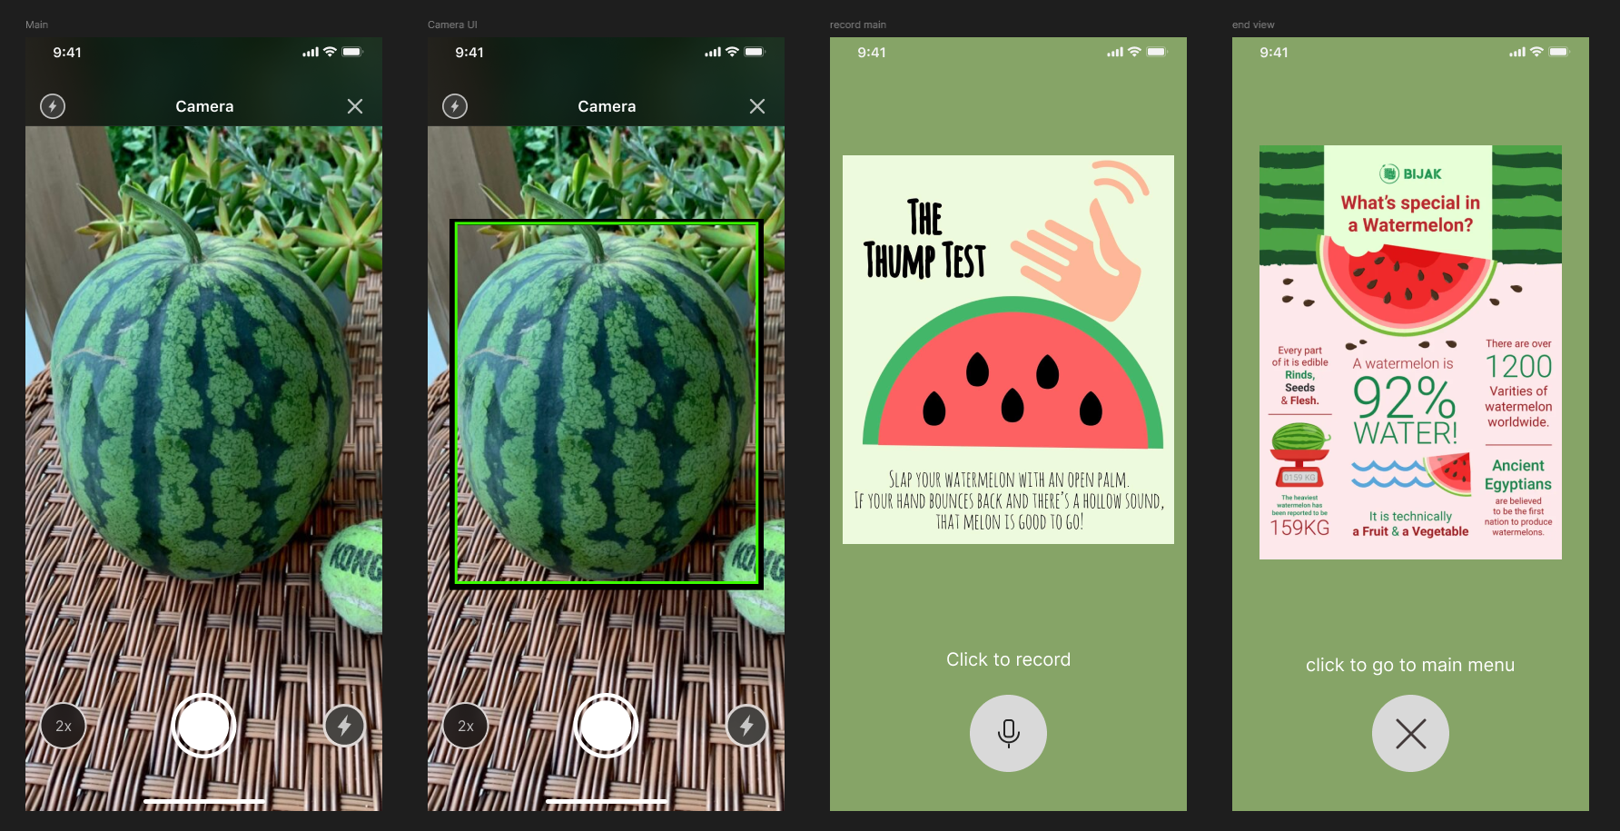
Front-end
Notes:
D

Slide 19
FR AND NFR
ID | Requirement
1 | The app should be user-friendly | NFR
2 | The app should correctly classify watermelon quality at least 90% of the time. | FR
3 | The app should work fast without significant delays | NFR
4 | The app should ask from the user to tap again if it was recorded in loud environment | FR
5 | The app should provide clear and easy to understand feedback | FR
Notes:
L

Slide 20
Refrences
Liu, J., Shi, H., Xia, Y., & Li, J. (2024). Non-destructive Ripeness Judgement of Watermelon Based on Mel Spectrogram and ECAPA-TDNN. ieeexplore.ieee.org
Xiao, B., Nguyen, M., & Yan, W. Q. (2023). Fruit Ripeness Identification Using YOLOv8 Model. link.springer.com
Zhang, L., Chen, R., Hao, H., He, E., Ning, M., Tang, J., & Fan, A. (2024). Watermelon Appearance and Knock Correlate Data Sets with Sugar Content. ieeexplore.ieee.org

Slide 21
Thanks !

